Slide 1
Hotel Revenue Management Report
Solution
Akshay Waghavakar | Associate Data Analyst
Nagpur | 03 July 2023
Classification: Confidential

Slide 2
Agenda
Problem Statements
Logical Data Model
Physical Data Model
Data Model
Report - Home Page
Report - Reservation Page
Reports(Visuals & summary)
Report questions?- Home Page
Report questions?- Reservation Page
Conclusion

Slide 3
Problem Statement
Hotels are struggling to optimize their revenue management strategies due to a lack of real-time insights, inefficient data analysis processes, and the absence of a comprehensive revenue management system.
As a result, they are experiencing suboptimal revenue performance, missed opportunities for revenue enhancement, and difficulties in adapting to changing market conditions.
In this report, we will delve into the specific challenges faced by hotels in revenue management and provide recommendations and solutions to address these issues. By addressing these challenges, hotels can improve their revenue performance, make data-driven decisions, and enhance their overall profitability in a highly competitive market.

Slide 4
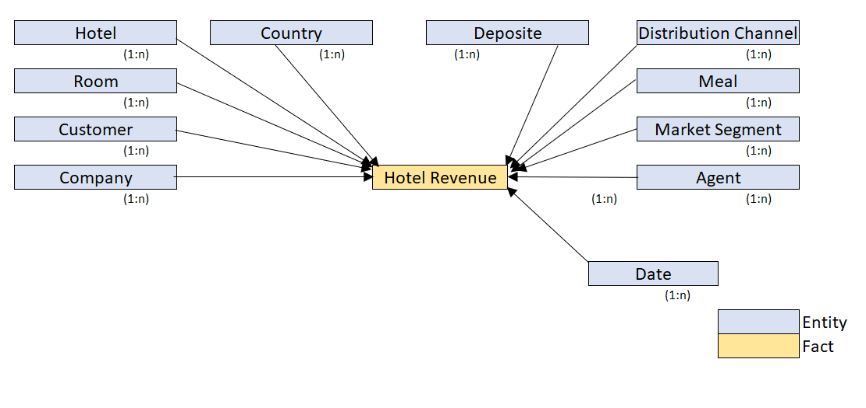
Logical Data Model

Slide 5
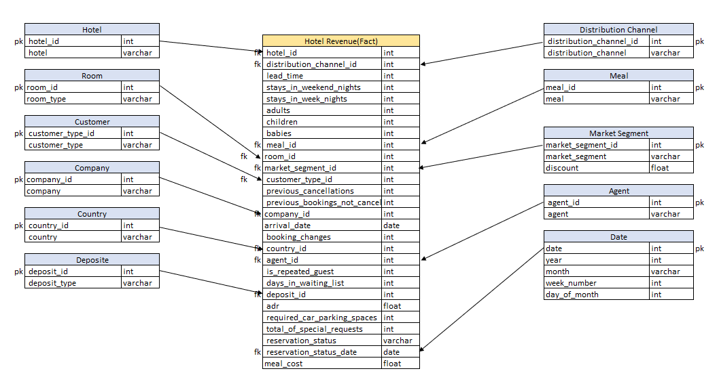
Physical Data Model

Slide 6
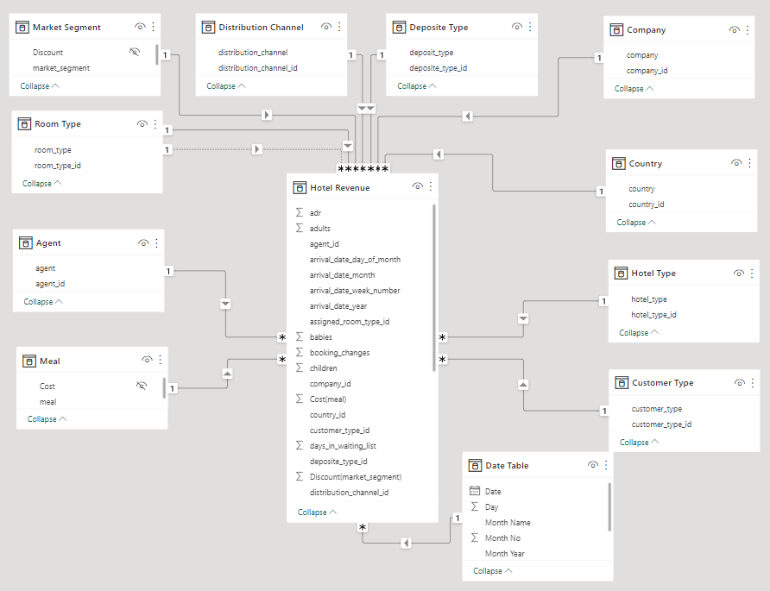
Data Model

Slide 7
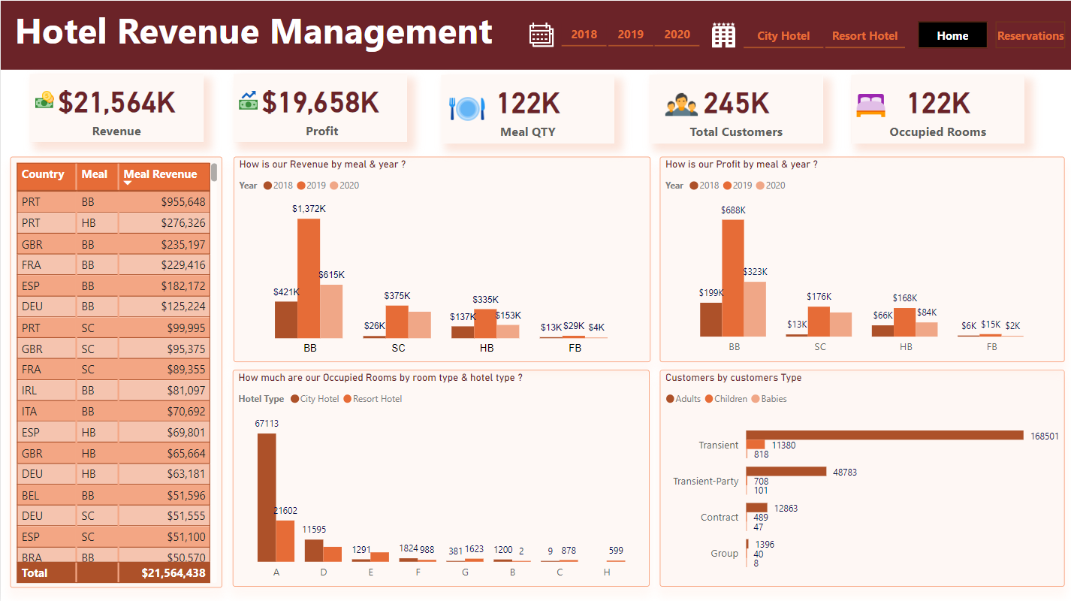

Slide 8
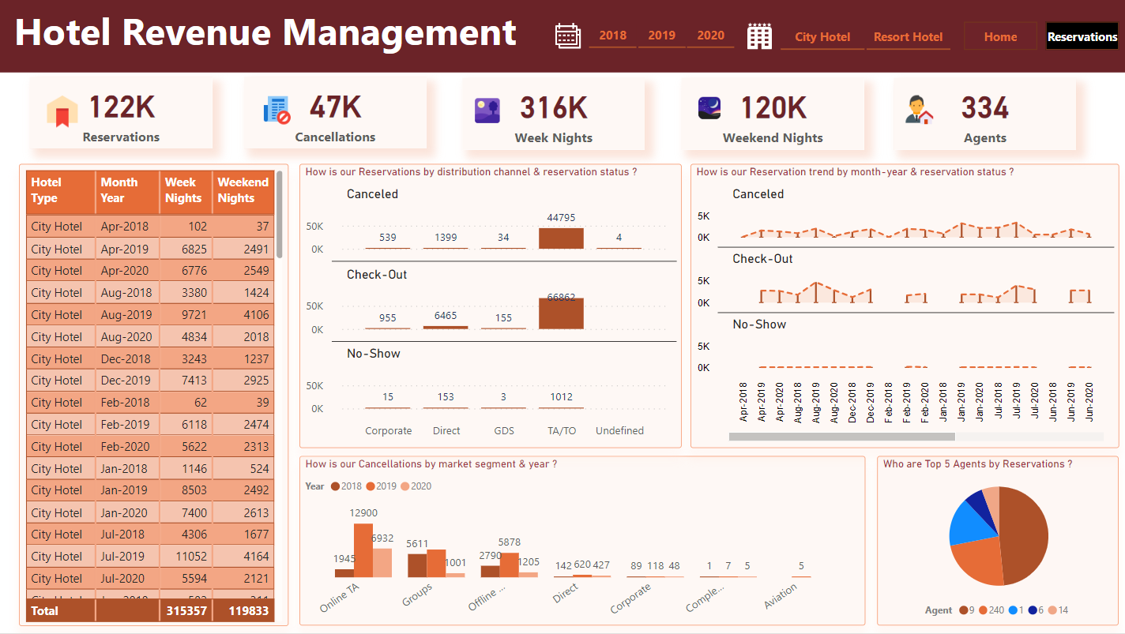

Slide 9
Key performance indicators (KPI)
The data represents the total value of revenue, profit, meal quantity, customers, occupied rooms, reservations, weeknights, weekend nights, agents.

Slide 10
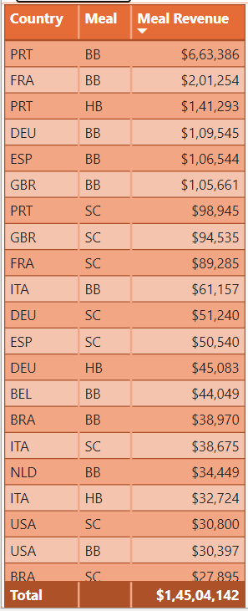
Meal Revenue by Meal and Country
This report provides a summary of meal revenue categorized by meal types and countries.
The data represents the total revenue generated from each meal type in various countries.
Table chart illustrating the revenue distribution by meal type and country.

Slide 11
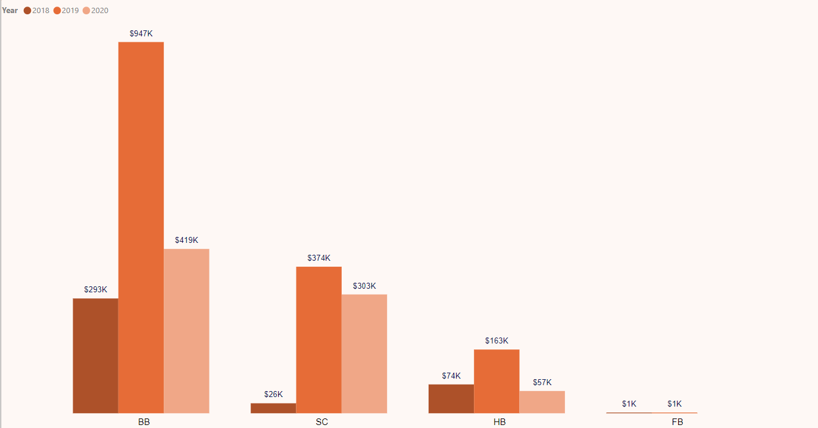
Meal Revenue by Meal and Year
This report provides a summary of meal revenue categorized by meal types and years.
The data represents the total revenue generated from each meal type for different years.
Clustered column chart illustrating the revenue distribution by meal type and year.

Slide 12
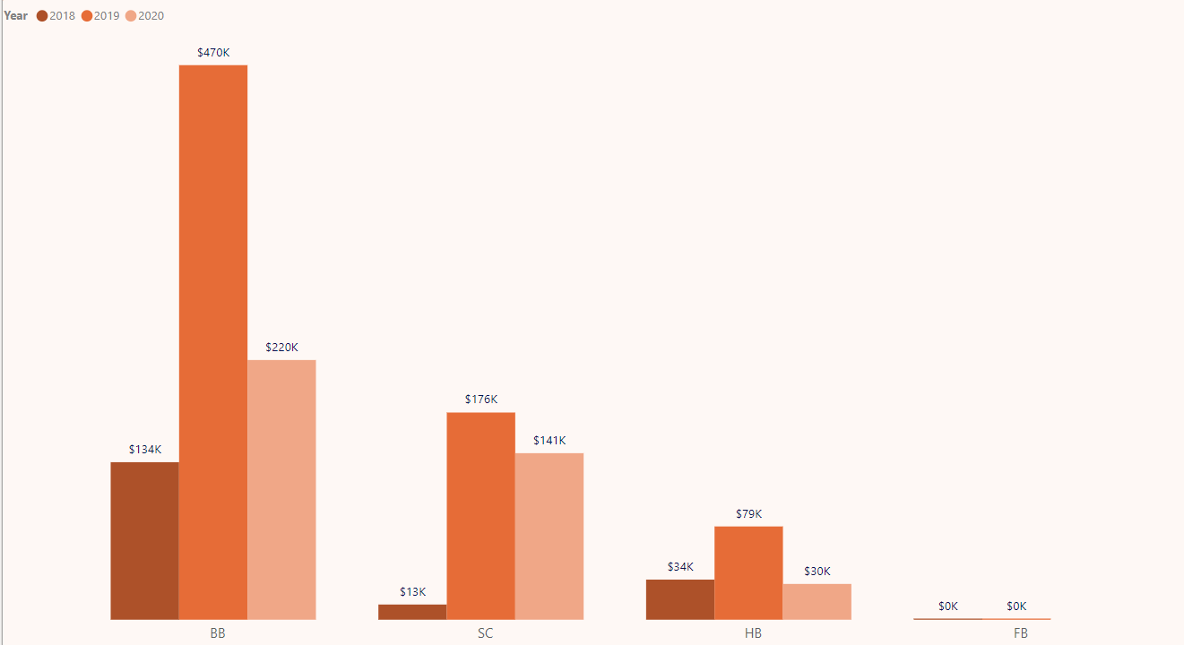
Meal Profit by Meal and Year
This report provides a summary of meal profit categorized by meal types and years.
The data represents the total profit generated from each meal type for different years.
Clustered column chart illustrating the profit distribution by meal type and year.

Slide 13
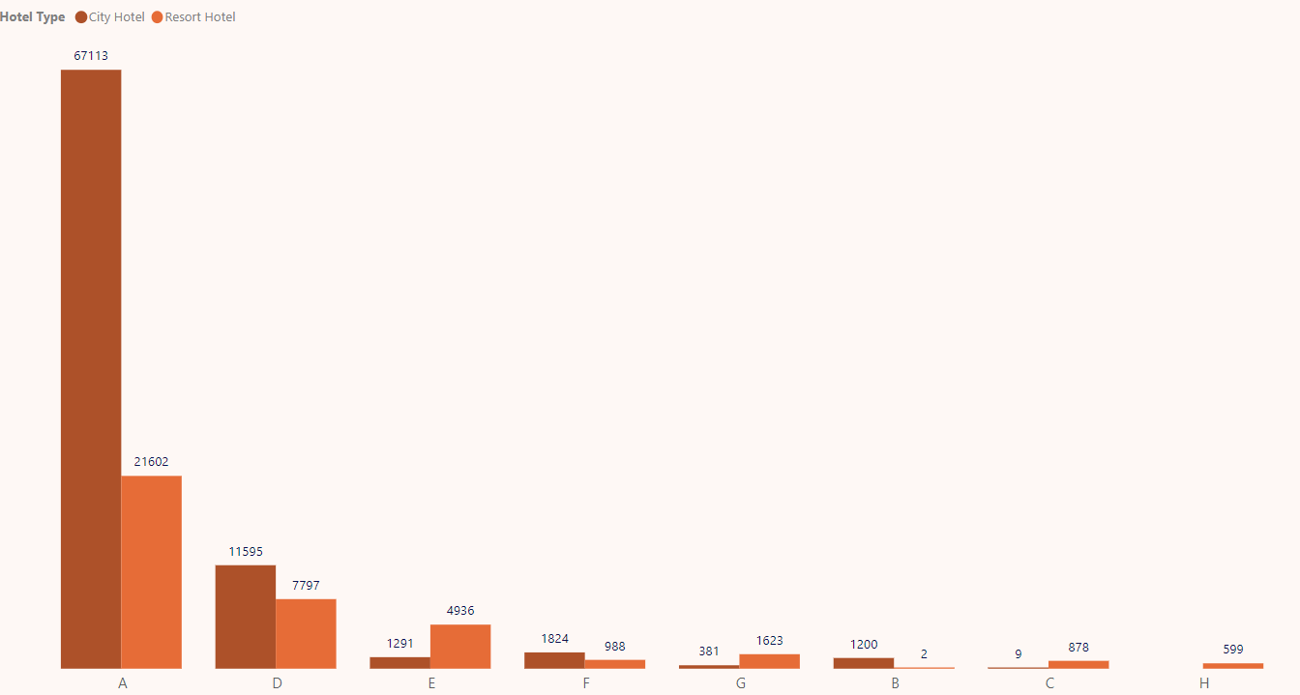
Occupied Rooms by Room Type and Hotel Type
This report provides a summary of occupied rooms categorized by room types and hotel types.
The data represents the total number of occupied rooms for each room type within different hotel types.
Clustered column chart illustrating the occupied rooms by room type and hotel type.

Slide 14
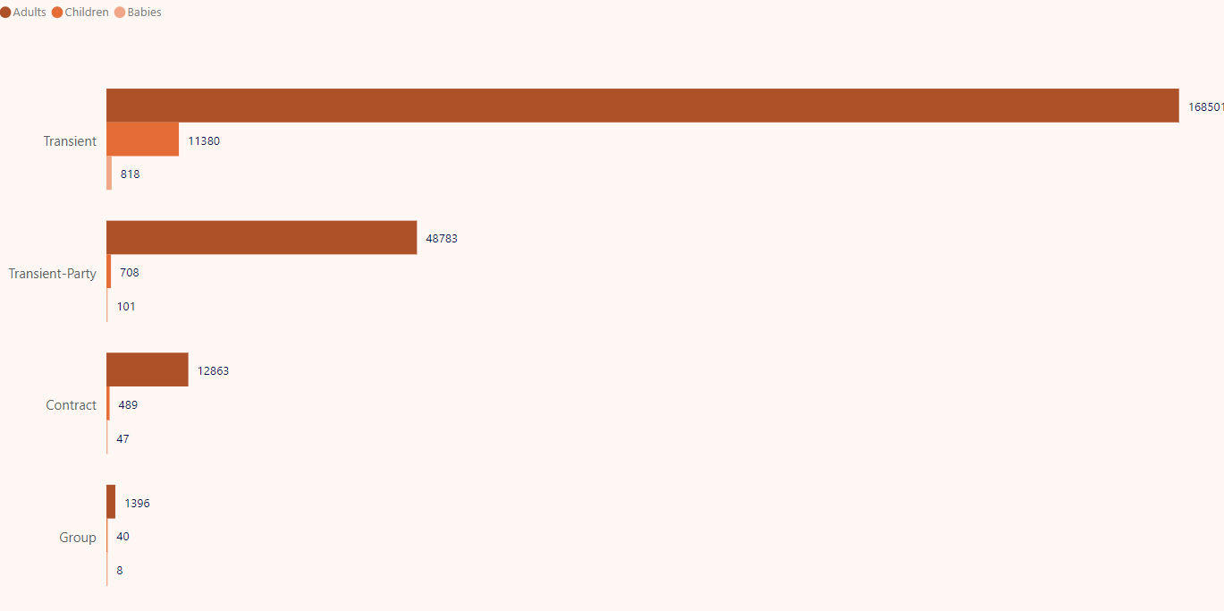
Customers by Customer Type and age group(Adults, Children, Babies)
This report provides a summary of customers categorized by customer types and the number of adults, children, and babies associated with each customer type.
The data represents the total count of customers within each category.
Clustered bar chart illustrating the customers by customer type and adults, children, babies.

Slide 15
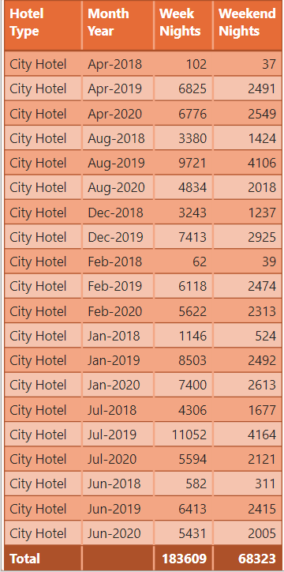
Nights by Hotel Type and Month-Year
This report provides a summary of the total number of weeknights and weekend nights booked for each room type, categorized by month and year.
The data represents the occupancy distribution based on the day of the week (weeknight: Monday to Thursday, weekend night: Friday to Sunday) for different room types.
Table chart illustrating the nights by hotel type and month-year.

Slide 16
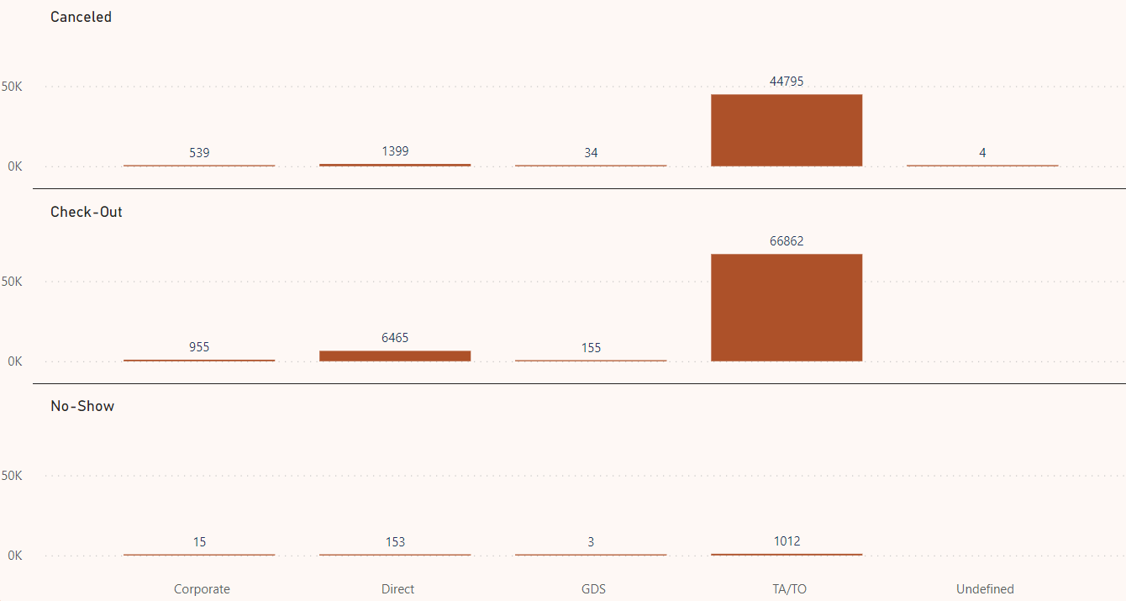
Reservations by Distribution Channel and Reservation Status
This report provides a summary of reservations categorized by distribution channels and reservation statuses.
The data represents the total count of reservations within each category.
Clustered column chart illustrating the reservations by distribution channels and reservation statuses.

Slide 17
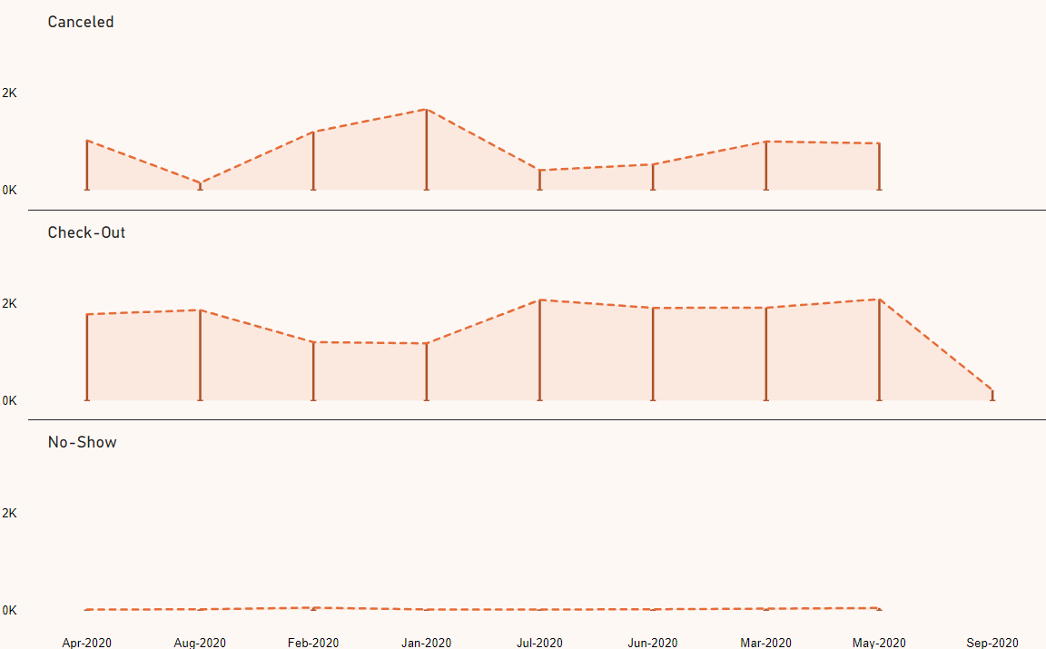
Reservations by Month-Year and Reservation Status
This report provides a summary of reservations categorized by month and year, as well as their corresponding reservation statuses.
The data represents the total count of reservations within each category.
Line chart illustrating the reservations by month-year and reservation statuses.

Slide 18
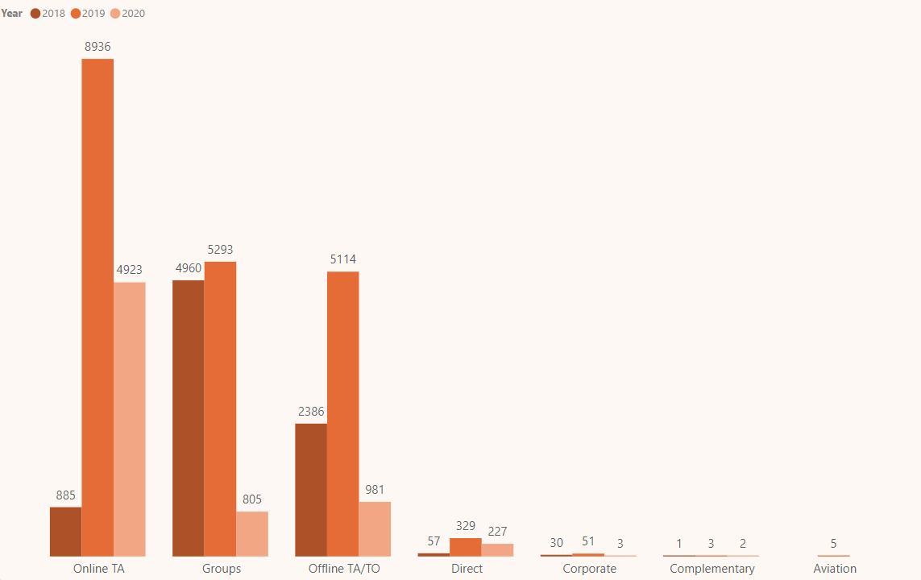
Cancellation by Market Segment and Year
This report provides a summary of cancellations categorized by market segments and years.
The data represents the total count of cancellations within each market segment for different years.
Clustered column chart illustrating the cancellation by market segment and year.

Slide 19
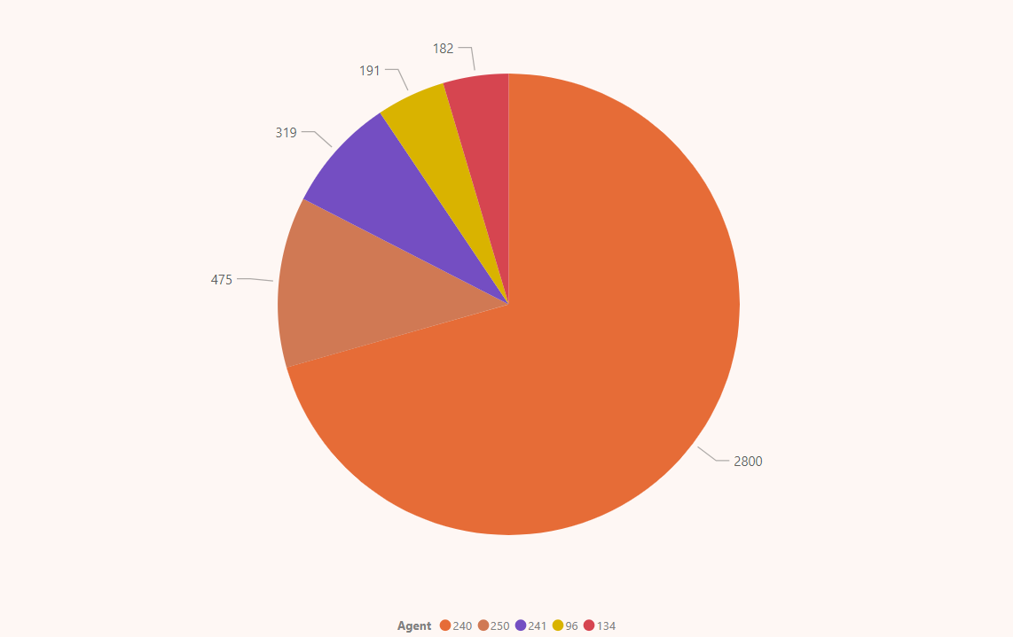
Top 5 Agents by Reservations
This report provides a summary of the top 5 agents who have made the highest number of reservations.
The data represents the total count of reservations for each agent.
Pie chart illustrating the top 5 agents by reservations.

Slide 20
Report Questions?- Home Page
What was the total revenue generated by each meal type across each country?
Which meal type generated the highest revenue in a particular year?
What was the total revenue generated by each meal type for each year?
What was the total profit generated by each meal type for each year?
Which meal type generated the highest profit in a particular year?
What is the total number of occupied rooms for each room type in each hotel type?
How many customers belong to each customer type and fall into different age groups(adults, children, babies)?

Slide 21
Report Questions? – Reservations Page
What is the distribution of weeknights and weekend nights by hotel type and month-year?
What is the distribution of reservations by different distribution channels and reservation statuses?
Which distribution channel is responsible for the highest number of reservations for each reservation status?
How does the number of reservations vary by month-year for each reservation status?
Are there any specific months or time periods that experience higher reservation activity for certain reservation statuses?
How many cancellations were made in each year for each market segment?
Who are the top 5 agents with the highest number of reservations?

Slide 22
Conclusion
A hotel revenue management dashboard is an invaluable tool for hoteliers to monitor, analyze, and optimize revenue performance.
It empowers decision-makers with real-time data and insights, enabling them to make informed decisions that enhance revenue, increase profitability.

Slide 23
“If we want a real frictionless hotel experience, we need to have frictionless hotel infrastructures” ― Simone Puorto

Slide 24
About Infocepts
Infocepts is a data solutions firm that enables improved business results through more effective use of data, AI & user-friendly analytics. Our mission is to bridge the gap between the worlds of Analytics and the Business. We partner with our clients to resolve the most common & complex challenges standing in their way of using data to strengthen business decisions.
Our Solutions
Info.AI
Data Fluency
Enhanced Product Support
Grow your Insights, not your team
Enterprise data translation solution
Invest in your future, not spend on your past
Hypercare
AIRcover
Automation as a Service
Modern. Innovative. Managed Services.
Dependable expertise. Always.
Scalable business automation strategy
Elastic Capacity
Analytics as a Service
Custom Support
Right talent. Right time. Anytime.
Turk-key Analytics, at the speed of your business
Custom solutions tailored for you
Agile +
Keystones
Employee 360
The power of Agile, without the headaches
Transformative technology-driven programs
AI-driven internal insights
For more information, visit www.infocepts.com or reach us at: sales@infocepts.com

